Slide 1
INFO5100 Final Project
Team Name: TeamName
Memebers: Lin, LiangYen/ 001304148
Tsai, YuTing / 001304955
Kuo, DahWei/ 001372878

Slide 2
Outline
Problem
Solution
Intro to Our Application :
Basic Concepts
Architecture
Enterprises and Organizations
Screenshots & work flows/ work requests
Global level
Demo

Slide 3
Problem
Due to resource inequality, medical resources are grouped in bigger cities, people live in remote area need to search for a better medical treatment in a bigger city.
People who are poor can’t afford medical treatment fee, even if they can, most of them cannot afford the hotel fee when they search for a better medical treatment in a big city.

Slide 4
Solution
Ronald McDonald’s House Charities (RMHC) has solved some of the housing problems when people search for medical treatment. However, they did not allow personal housing offered.
We believe that kind people can also provide free rooms for those who cannot afford the hotel. So we combine the idea of Airbnb and RMHC.
With proper management, we can help a patient/ patient’s family, by providing them a suitable room.

Slide 5
Intro to Our Application
Basic concept of the system:
Allows people or company to offer their rooms for people who need it.
Allows people who need it to apply for a room.
Coordinate enterprise can approved the rooms offered by companies/person,
and the applications from clients/patients.
Coordinate enterprise can match the rooms for the clients.

Slide 6
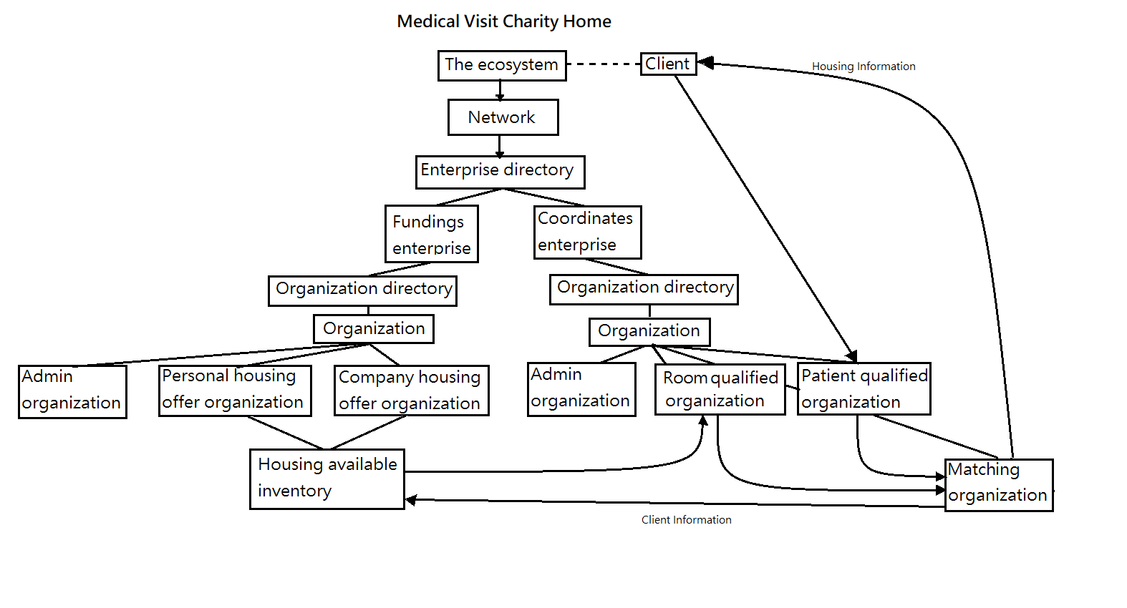
Intro to Our Application
Architecture:

Slide 7
Intro to Our Application
Enterprises:
Funding enterprises
Coordinate enterprises
Organizations:
Patients/ Rooms qualified organization
Clients organization
Matching organization
Personal housing offers organization
Company housing offers organization
Admin organization

Slide 8
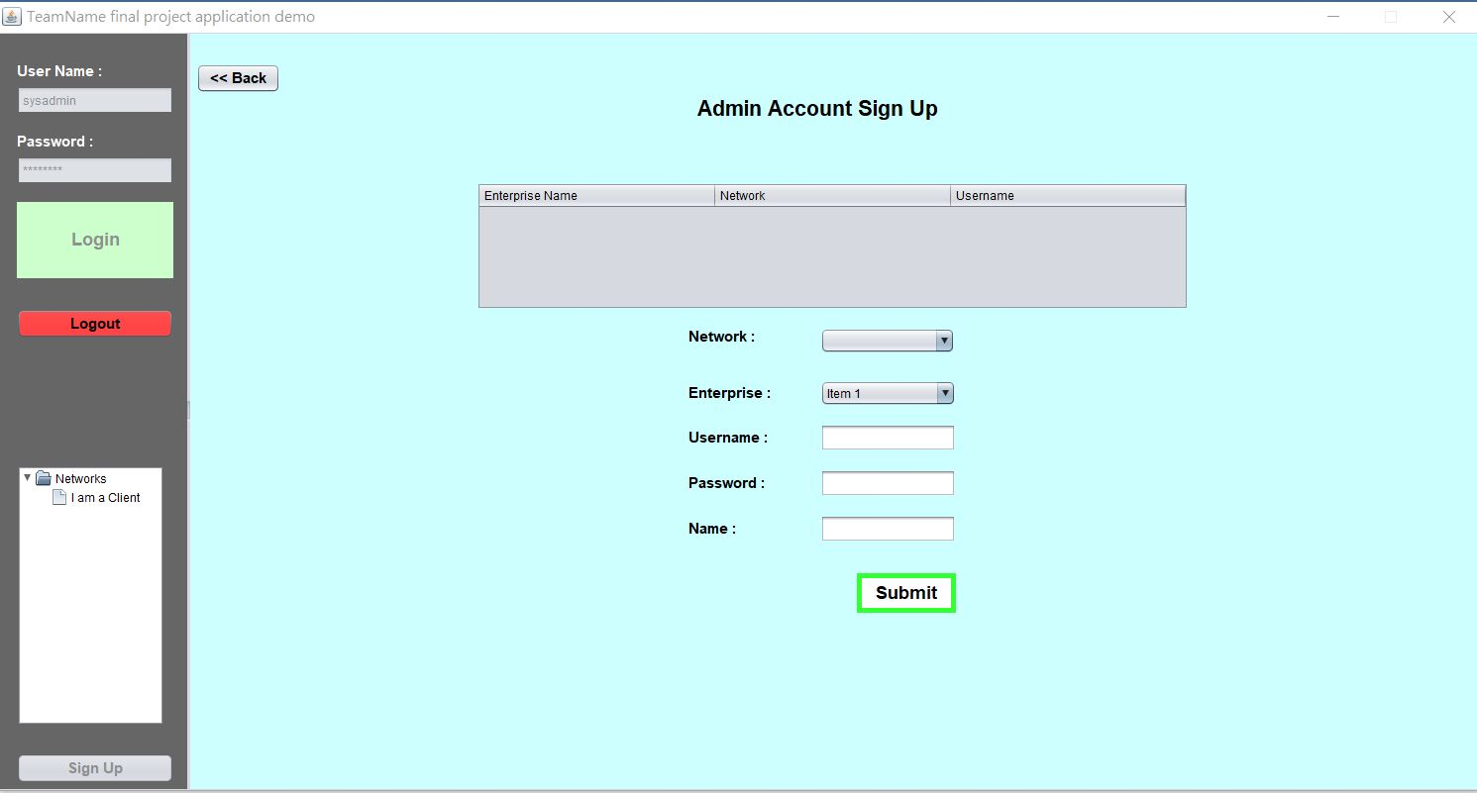
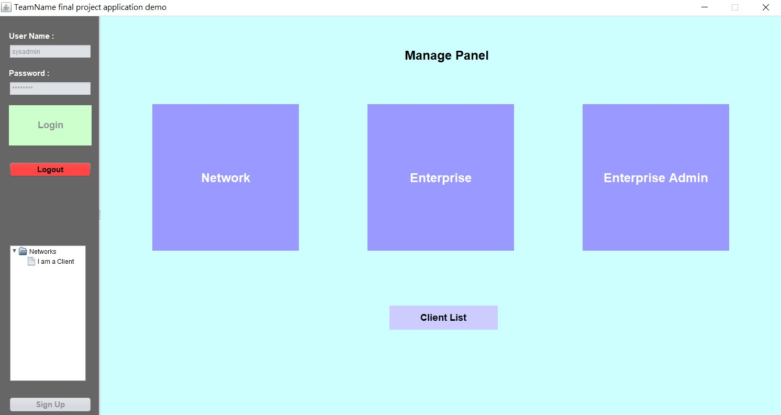
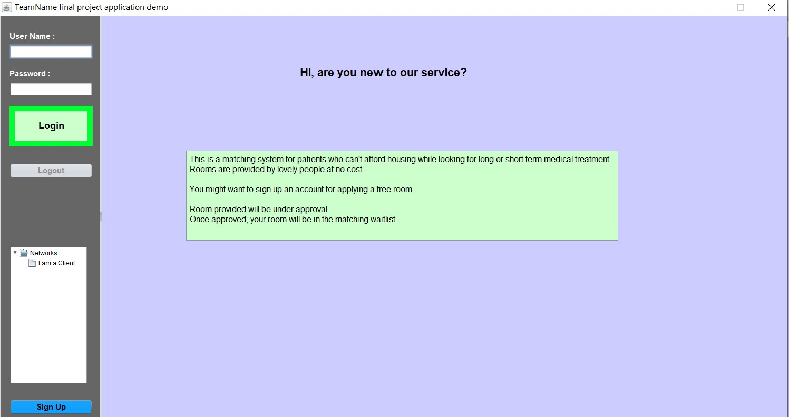
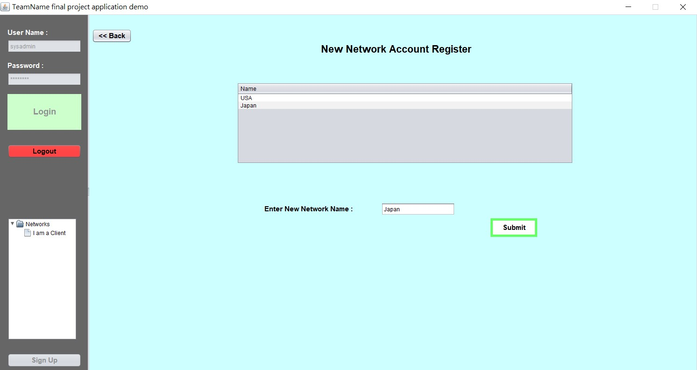
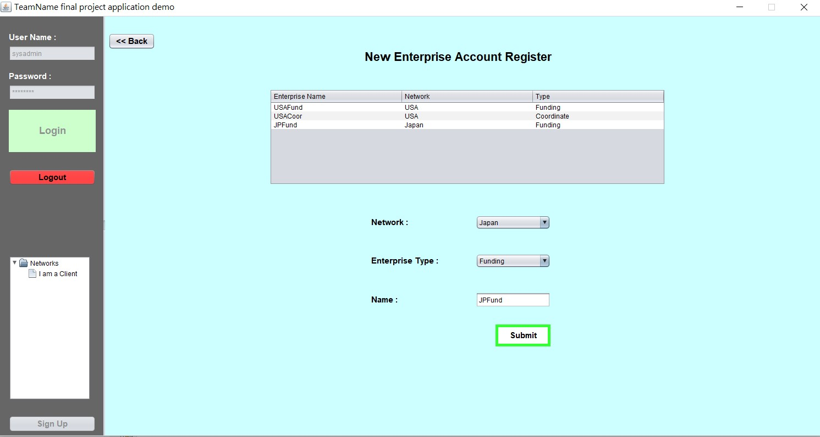
Intro to Our Application
Key screenshots & work flows/ work requests:

Slide 9
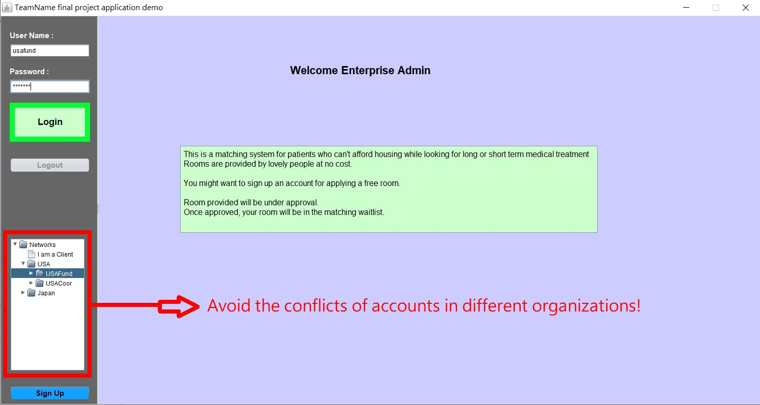
Notes:
screenshots

Slide 10
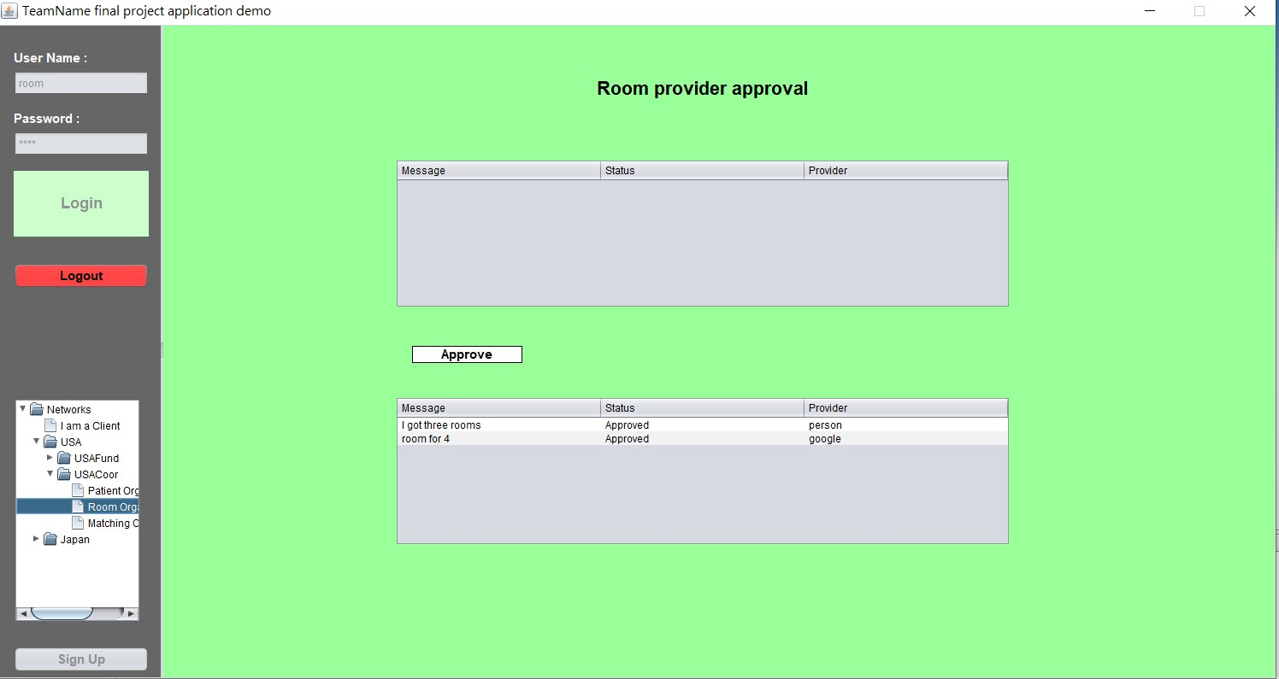
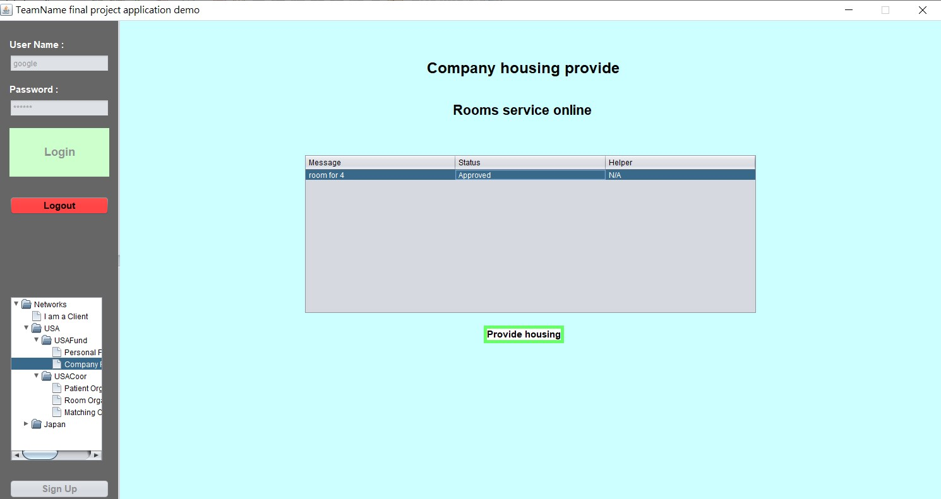
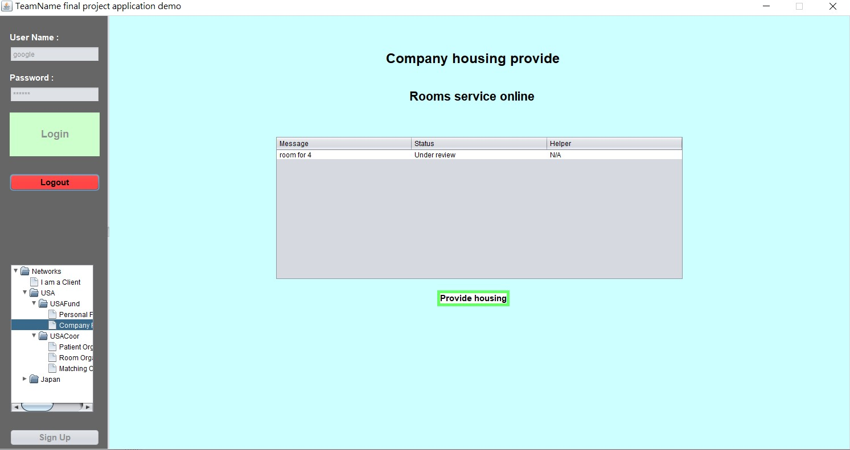
Work Request (Room Offer)

Slide 11
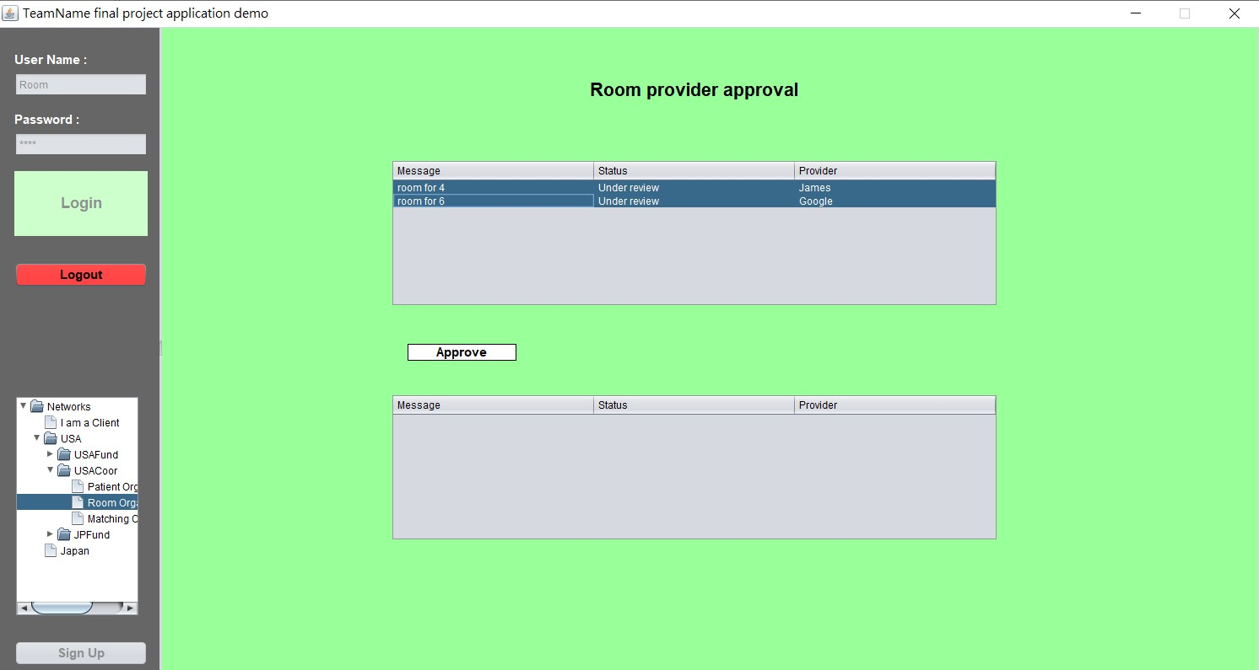
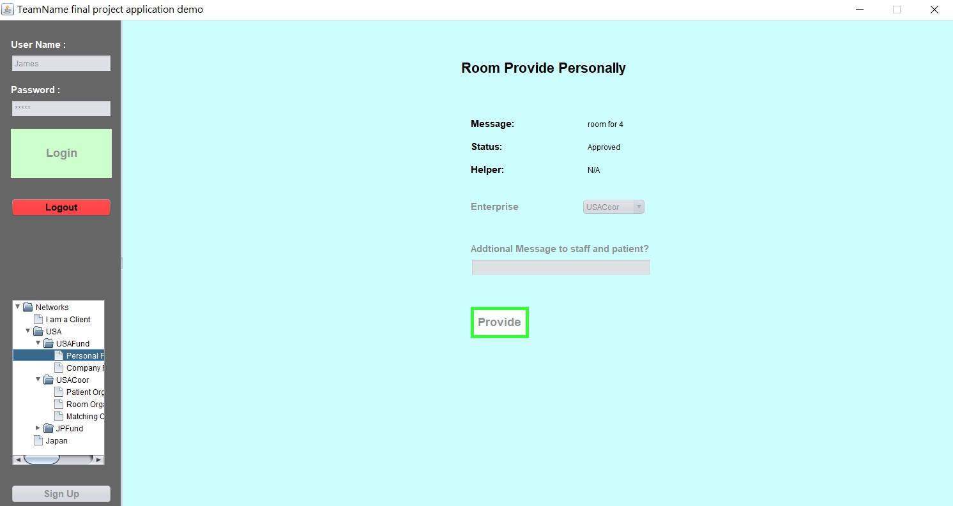
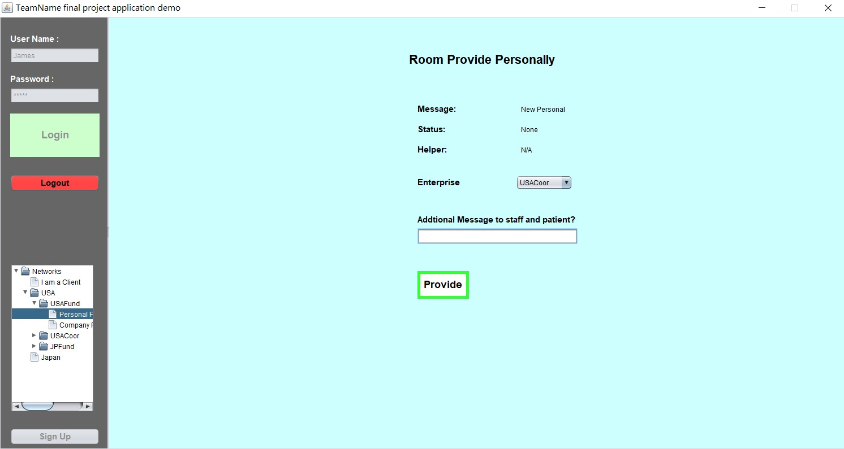
Personal Room Offer

Slide 12

Work flow of room:
Company/ Person offers room. (Status: Under review)
Room organization can approve the rooms offered.
Company/ Person offered room status becomes approved.

Slide 13
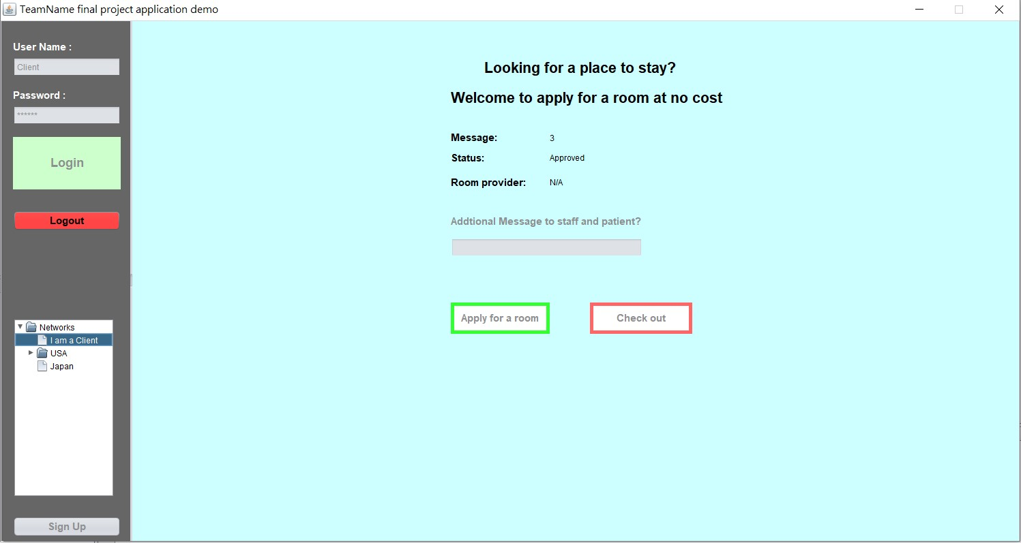
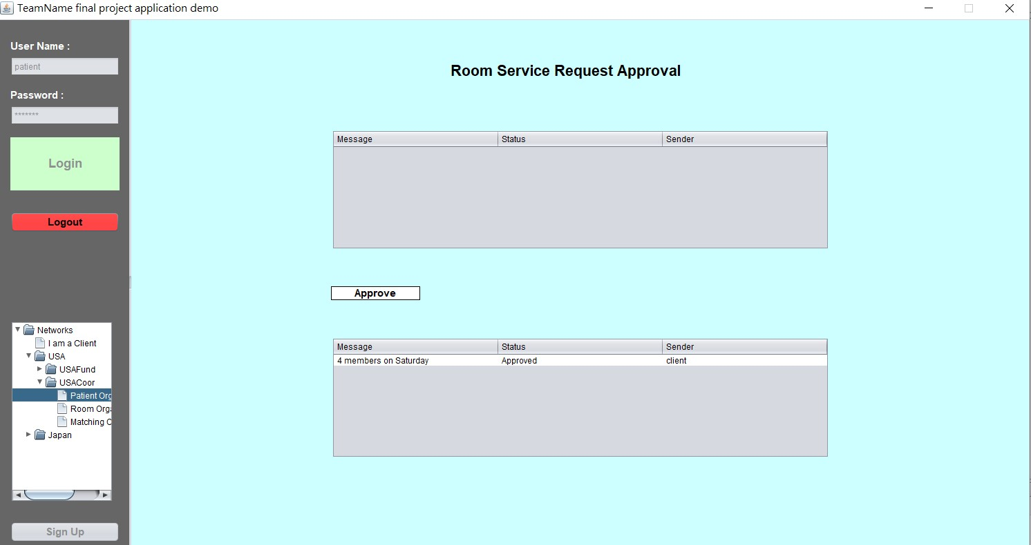
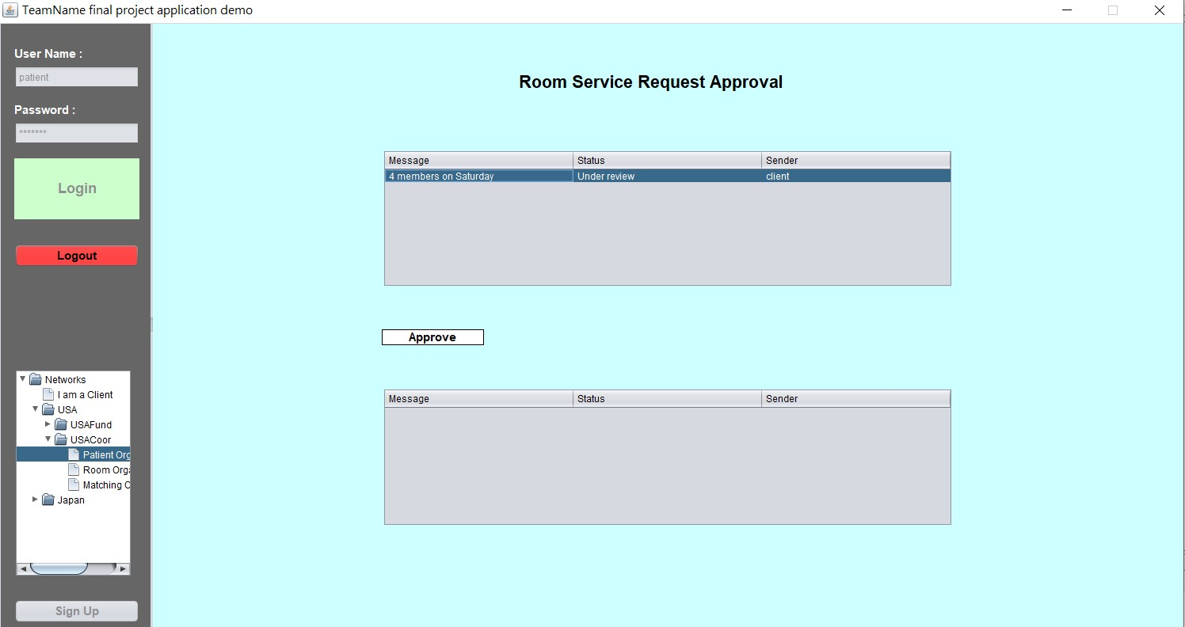
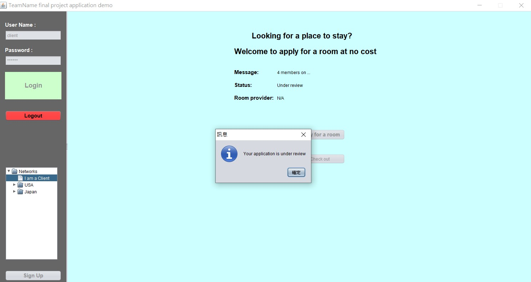
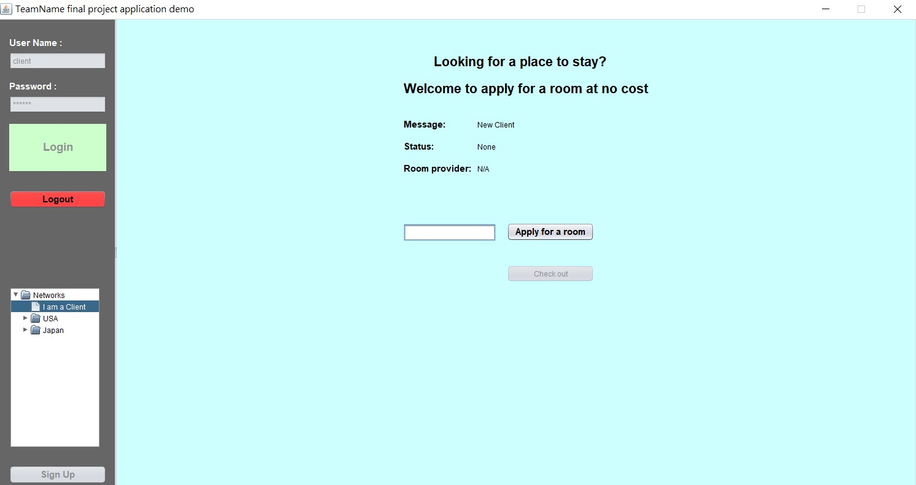
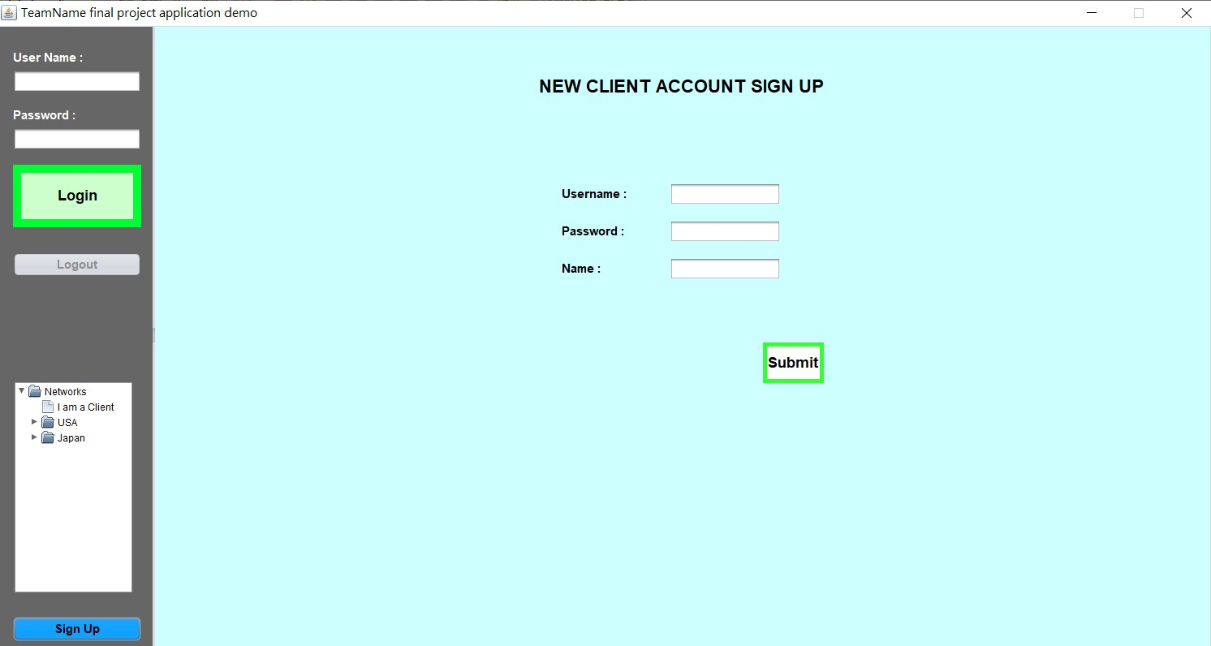
Work Requests (client book a room)

Slide 14
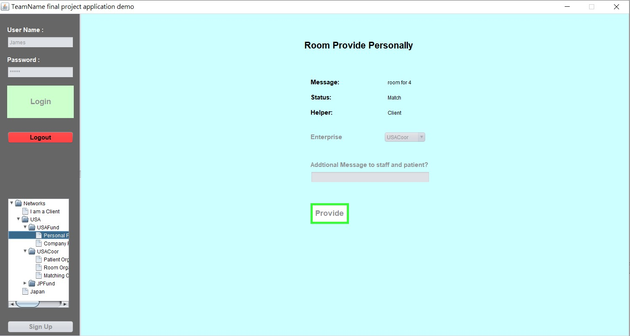
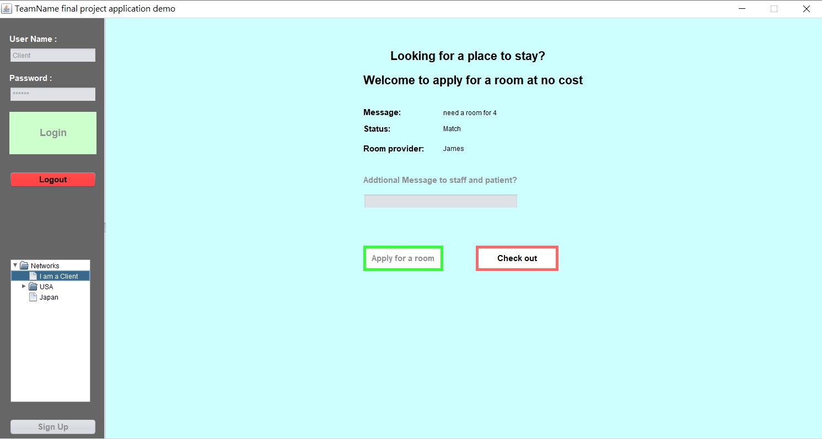
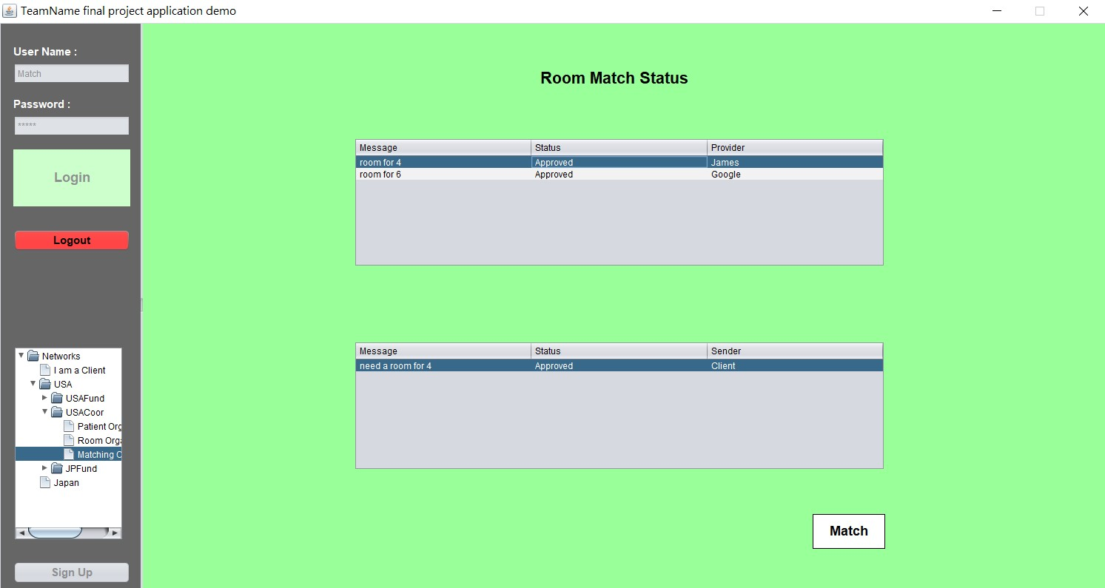
Matching Organization:
Notes:
***要加match & check out

Slide 15
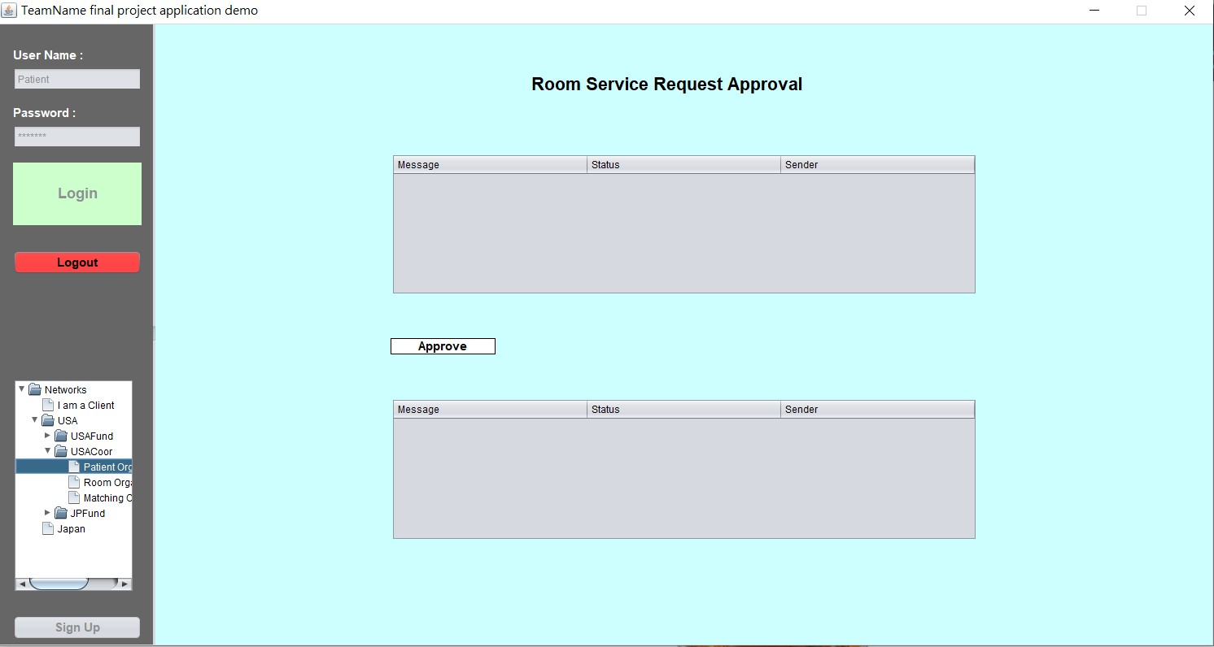
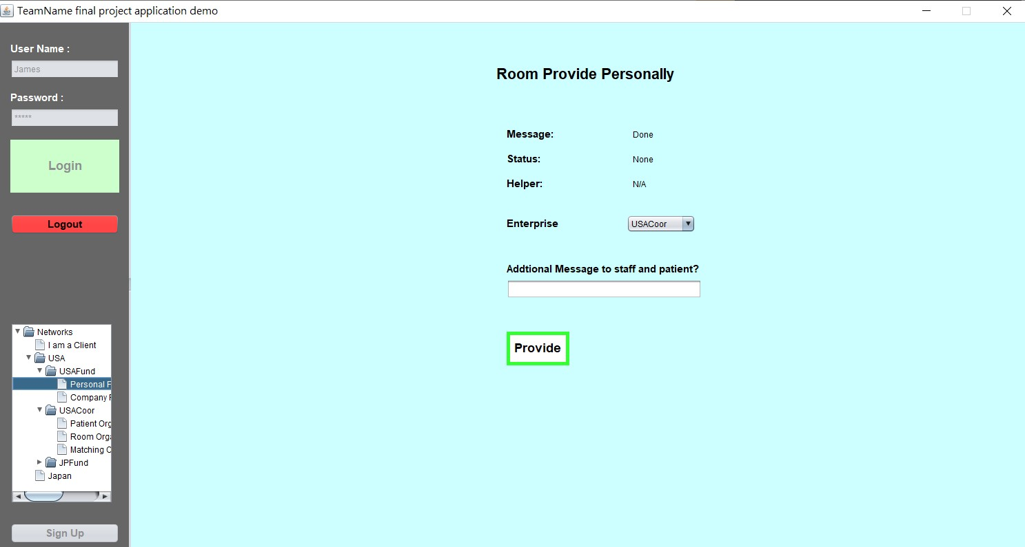
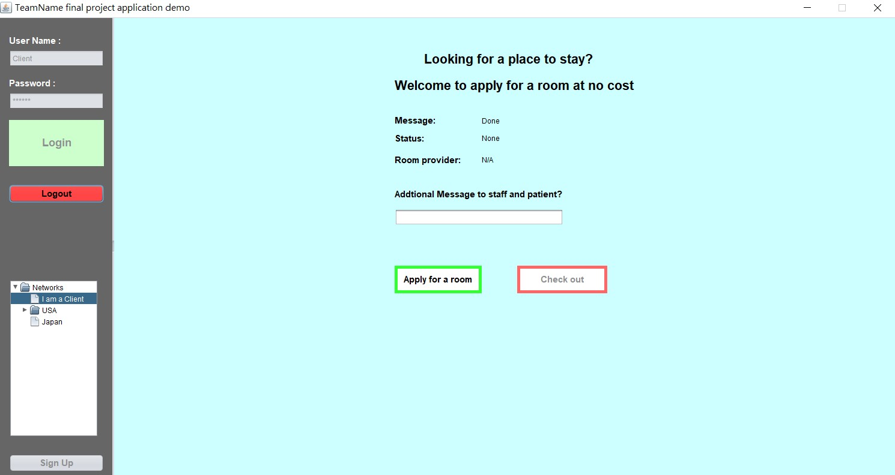
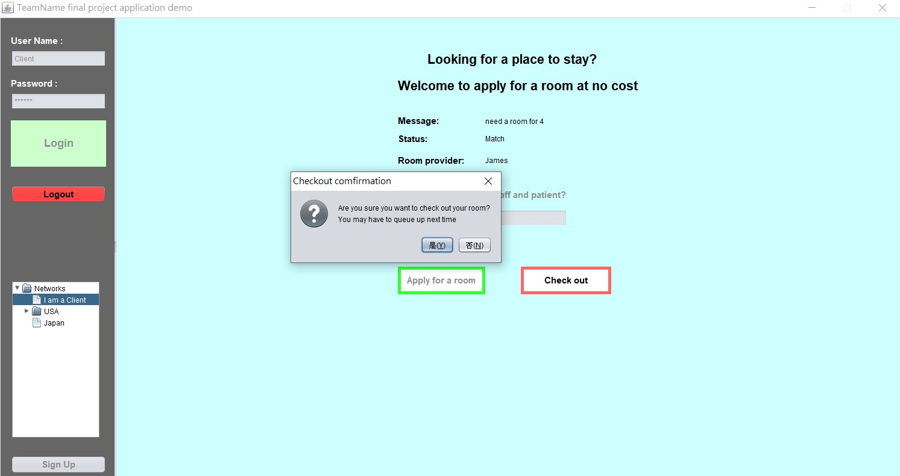
When a client check out:

Slide 16
Work flow of applying a room:
Client should set up an account first, then apply for a room. (Status : under review)
Patient organization can approve the application of a client.
Matching organization can match the room and the clients.
When successfully matched, the status becomes match!

Slide 17
Global Level
Global companies like Google, Facebook, Apple, they can be the funding enterprises.
With the help of local coordinate enterprises, this system can be spread around the world.
Notes:
And why would a global company do it for free?
It can improve the reputation of the company.
They can give back to the society.
It will definitely bring a great commercial effect. Maybe the money they save on advertising is less than the money they help the charity.

Slide 18
Thanks for your time!

